Slide 1
Intensive Supervision Probation (or Parole)
Initial Rise to Prominence
Research on First Gen ISP Programs
Finding Something Useful in ISP

Slide 2
The rise of ISP programs
The most prominent example of intermediate sanction programs from the 1980s
Promised multiple things
Reduce prison crowding, save money
Reduce recidivism
Provide new alternatives for judges
Reaction to the perception that probation was “failing”
RAND report from 1985 → ISP as a “promising new idea”

Slide 3
The Nature of ISP
Lower caseloads (15-30 probationers)
Increased contact with P.O.
Drug testing
Employment verification
EM/Home confinement

Slide 4
Research on ISP
Initial studies were promising…but deeply flawed
“Georgia Model”
Punishment philosophy
Georgia report in 1982: “Turning up the Heat on Probationers”
Only a 16% re-incarceration rate for ISP
Resulted in a 10% reduction in felons sentenced to prison

Slide 5
RAND Experiments
Federal (NIJ) sponsored research: Do ISP programs “work?”
Choose the ISP
Enhancement
Probationers → Turn up heat
Diversion
Prisoners → Monitor in community instead
Sites had to follow guidelines to get money
Use “Georgia model” and allow RAND to randomly assign people to ISP or control group

Slide 6
Diversion Sites
Only 2 of 14 sites chose diversion
Milwaukee, WI
Judge overrode random assignment, study broke down
Oregon
Out of 160 “eligible,” only 28 referred to program after 2 years
ISP more expensive than originally thought
75% of prison costs, more than twice as much as regular probation

Slide 7
Enhancement Sites
ISP programs increased commitments to jail and prison
After one year, 27% of ISP in jail/prison, but only 19% of control groups
ISP programs did not reduce arrests for new offenses: All sites combined
ISP = 37% rearrested
Regular Probation = 33% rearrested

Slide 8
Enhancement II
Technical Violations
12/14 sites had violation rates above 50%, four had rates above 80%
Could claim this as a victory (catching them early), but violations were not related to criminal offending.
Implementation: were they done right?
YES
More drug testes, more PO contact, more monitoring (EM, curfew, home visits, work visits)

Slide 9
First Generation ISP: Conclusions
“Turning up the heat” didn’t reduce crime
May make things worse though “fishbowl effect”
Already knew this from “magic caseload” rehabilitation research in the 1970s
ISP is not likely to divert people from prison
Sole Victory?
ISP is more “painful” than regular probation
Offenders equate 3 years of ISP with 1 year of prison

Slide 10
ISP Survive Negative Research
ISP program did not decline after negative findings
Why would any jurisdiction still use an ISP program?
Some ISP programs began to morph into treatment orientation
Use ISP as hammer to enforce treatment
Initial research “promising” but limited: ISP people that did treatment had lower recidivism rates

Slide 11
Lowenkamp and friends study
Research question
Can ISP programs be effective?
Do ISP programs with a “human service” approach do better than those with the traditional “deterrence” approach?
Do ISP programs with more integrity work better?
Follow the “principles of effective intervention”
Well trained staff, use treatment manual, follow risk principle

Slide 12
Methodology
A “meta-analysis” of comparisons between ISP programs and control groups
Effect size = measure of difference between groups
Negative = ISP did worse
Effect size of .10 would mean: ISP: 45% failure
Control: 55% failure

Slide 13
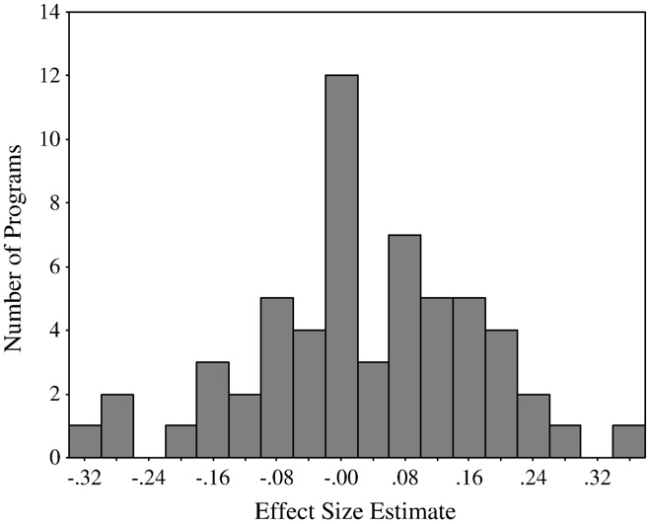
Effect sizes (lots of variation)

Slide 14
Did human service do better?
Average effect for deterrence = -.11
ISP 56% failure
Control 47% failure
Average effect for human service = .06

Slide 15
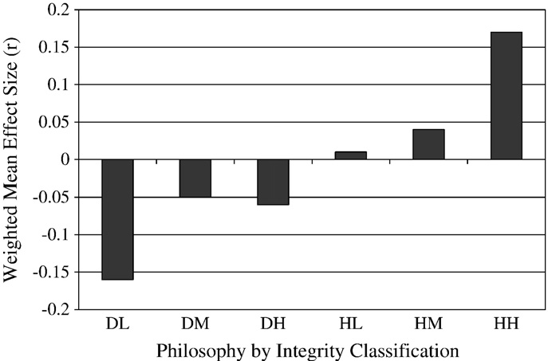
The effect of integrity

Slide 16
So you see Timmy…
Deterrence oriented ISP programs are ineffective, regardless of treatment integrity
Human services oriented ISP programs have the potential to reduce recidivism
Treatment integrity has to remain high
Policy implication?
Need to talk the “true believer” zero tolerance deterrence probation departments down off that cliff
Training, information dissemination

